Slide 1

Introduction to Git & GitHub

Slide 2
Git
What is Git?
Git is a version control system.
Git helps you keep track of code changes.
Git is used to collaborate on code.

Slide 3
Git
What does Git do?
Manage projects with Repositories
Clone a project to work on a local copy
Control and track changes with Staging and Committing
Branch and Merge to allow for work on different parts and versions of a project
Pull the latest version of the project to a local copy
Push local updates to the main project

Slide 4
Git
Using Git with Command Line?
Git version?
git --version
git version 2.40.0.windows.1
Configure Git?
git config --global user.name “your_github_name"
git config --global user.email “your_github_email@gmail.com"
Creating Git Folder?
mkdir myproject
cd myproject
Creating Git Folder?
git init
Initialized empty Git repository in /Users/user/myproject/.git/

Slide 5
Git
Git Adding New Files?
Create index.html?
touch index.html
Confirm the file?
ls
git status
Git Log?
git log

Slide 6
Git
Git Staging Environment?
As you are working, you may be adding, editing and removing files. But whenever you hit a milestone or finish a part of the work, you should add the files to a Staging Environment
Staged files are files that are ready to be committed
Stage a single file?
git add index.html
git status
Stage many files?
git add –all OR git add . OR git add -A

Slide 7
Git
Git Commit?
Since we have finished our work, we are ready move from stage to commit
for our repo. When we commit, we should always include a message
git commit -m "First release of Hello World!"
Git Commit without Stage?
Git Help?
Note: Short status flags are:
?? - Untracked files
A - Files added to stage
M - Modified files
D - Deleted files
Git help –all
Git help add
Example?
git commit -a -m "Updated index.html with a new line"
Warning: Skipping the Staging Environment is not generally recommended.

Slide 8
Git
Git Branch?
In Git, a branch is a new/separate version of the main repository
New Git Branch?
git branch hello-world-images
New Git Branch?
git branch hello-world-images
git branch
List all Branches?
git branch
Switching to existing Branches?
git checkout hello-world-images
Switching and Creating a new Branche?
git checkout -b emergency-fix

Slide 9
Git
Branch Merge?
We have the emergency fix ready, and so let's merge the master and
emergency-fix branches.
Switch to Your main[master]?
git checkout master
Merge with hello-world-images ?
git merge hello-world-images
Delete the Merged branch?
git branch –d hello-world-images
Confirm available Branches?
git branch

Slide 10
Git
Creating a Merge Conflict?
Merge Conflict : occurs when Git cannot automatically resolve differences between two commits during a merge process
We need two branches master and hello-world-images which are all in sync
Make changes to master, and commit. Then make changes to hello-world-images
Switch to master and merge. [🤣🤣🤣🤣🤣]
Switch to Your master?
git checkout master
Merge with hello-world-images ?
git merge hello-world-images
Resolve the changes on index.html file then?
git add index.html
git status
git commit -m "merged with hello-world-images after fixing conflicts"

Slide 11
😯😯➡➡➡➡GitHub Incoming➡➡➡➡😏😏😏

Slide 12



GitHub
What is GitHub?
Git is not the same as GitHub.
GitHub makes tools that use Git.
GitHub is the largest host of source code in the world, and has been owned by Microsoft since 2018.

Slide 13
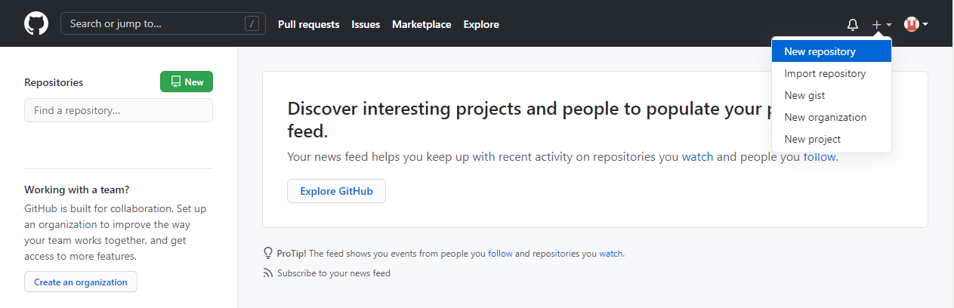
GitHub
Create a Repository on GitHub

Slide 14
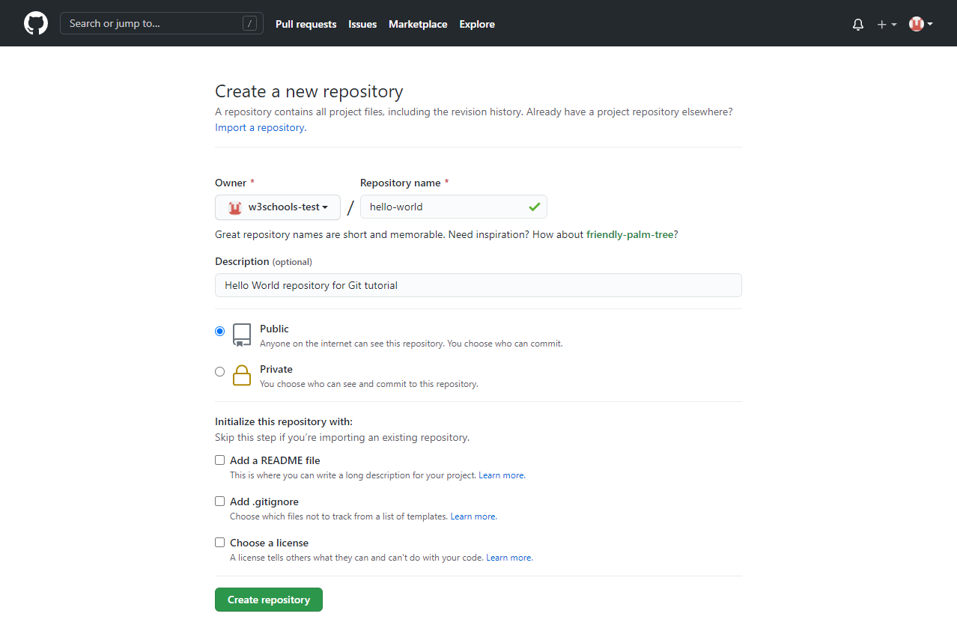
GitHub
Create a Repository on GitHub

Slide 15
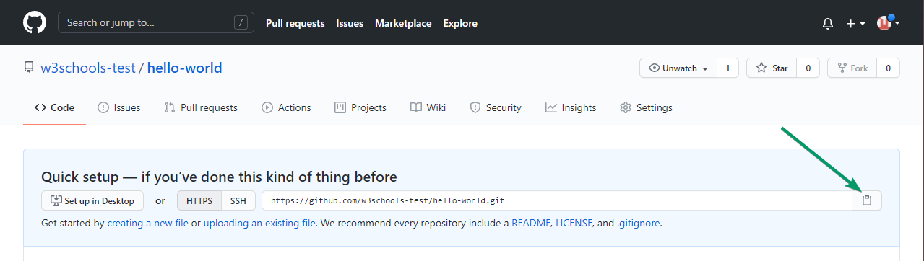
GitHub
Push Local Repository to GitHub
Copy the URL, or click the clipboard marked in the image above.
Now paste it the following command:
git remote add origin https://github.com/your-username/gitrepo.git

Slide 16
GitHub
Connect our Local Repository to GitHub
Push to github
git push --set-upstream origin master
Pull from GitHub
pull is a combination of 2 different commands:
Fetch - gets all the change history of a tracked branch/repo.
Merge - combines the current branch, with a specified branch
git pull origin - update our local Git:
Push Changes to GitHub
git commit -a -m "Updated index.html for push to github"

Slide 17


GitHub
Git Undo
Git Revert
revert is the command we use when we want to take a previous commit and add it as a new commit, keeping the log intact
Step 1: Find the previous commit:
Step 2: Use it to make a new commit:

Slide 18
GitHub
Git Revert
Find commit in Log
git log --oneline
Git Revert HEAD
This command will create a new commit that undoes the changes from the most recent commit.
git revert abc123
This command will create a new commit that undoes the changes from the commit with the hash "abc123". Replace "abc123" with the actual hash of the commit you want to revert.
git revert HEAD~2..HEAD
This command will create a new commit that undoes the changes from the two most recent commits.

Slide 19
Git
GIT REBASE
Git rebase is a command that allows developers to integrate changes from one branch to another.
Git rebase compresses all the changes into a single “patch.” Then it integrates the patch onto the target branch. Unlike merging, rebasing flattens history. It transfers the completed work from one branch to another. In the process, unwanted history is eliminated.
Git Rebase vs. Merge Similarities
Git rebase and merge both integrate changes from one branch into another. Where they differ is how it's done. Git rebase moves a feature branch into a master. Git merge adds a new commit, preserving the history

Slide 20
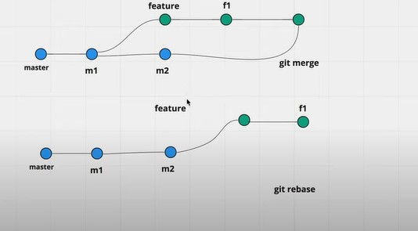
Git
Git Rebase vs. Merge : Differences
Git Rebase
Streamlines a potentially complex history.
Avoids merge commit “noise” in busy repos with busy branches.
Cleans intermediate commits by making them a single commit, which can be helpful for DevOps teams.
Git Merge
Simple and familiar.
Preserves complete history and chronological order.
Maintains the context of the branch.

Slide 21
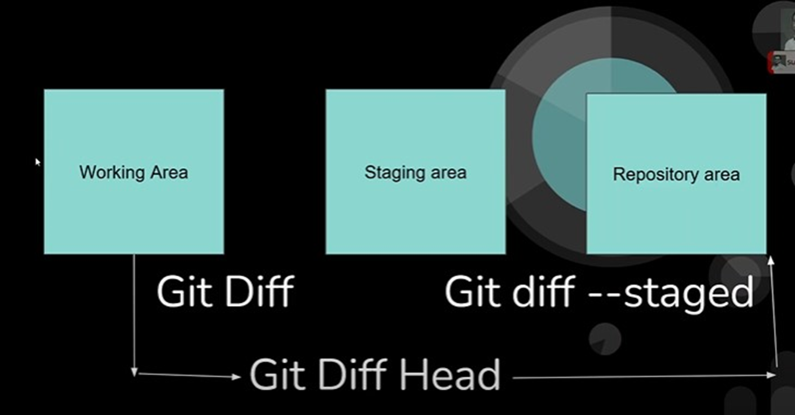
Git
Git diff
git diff command is used in git to track the difference between the changes made on a file. Since Git is a version control system tracking changes are something very vital to it. Diff command takes two inputs and reflects the differences between them. It is not necessary that these inputs are files only. It can be branches, working trees, commits, and more.
Changes that have made and are not yet committed
What changes are not staged

Slide 22
Git
Git diff commits
Comparing files between two different commits
git diff 7514eeb2a2713dac16dc27ad6a71aea92f2bb4f0 cb9e6e409a50028416957e4d0ec9a40dffec6224
Git diff branches
Git diff branch1 branch2

Slide 23
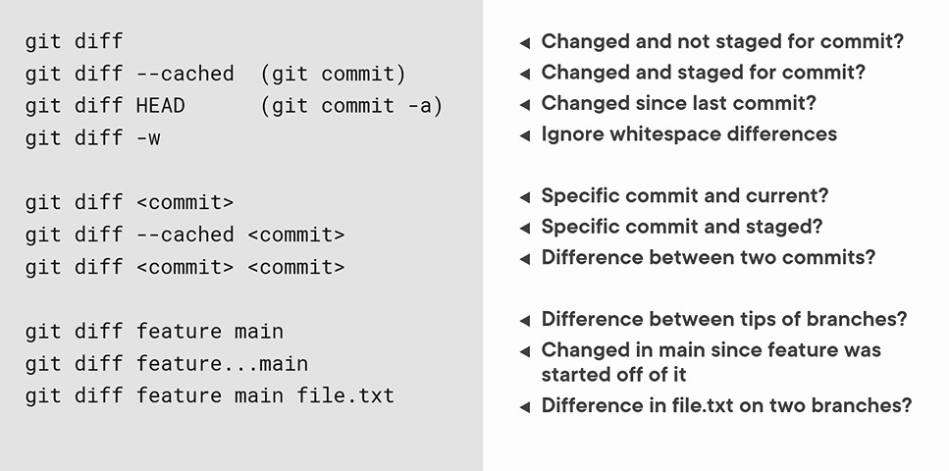
Git
Git diff CheatSheet

Slide 24
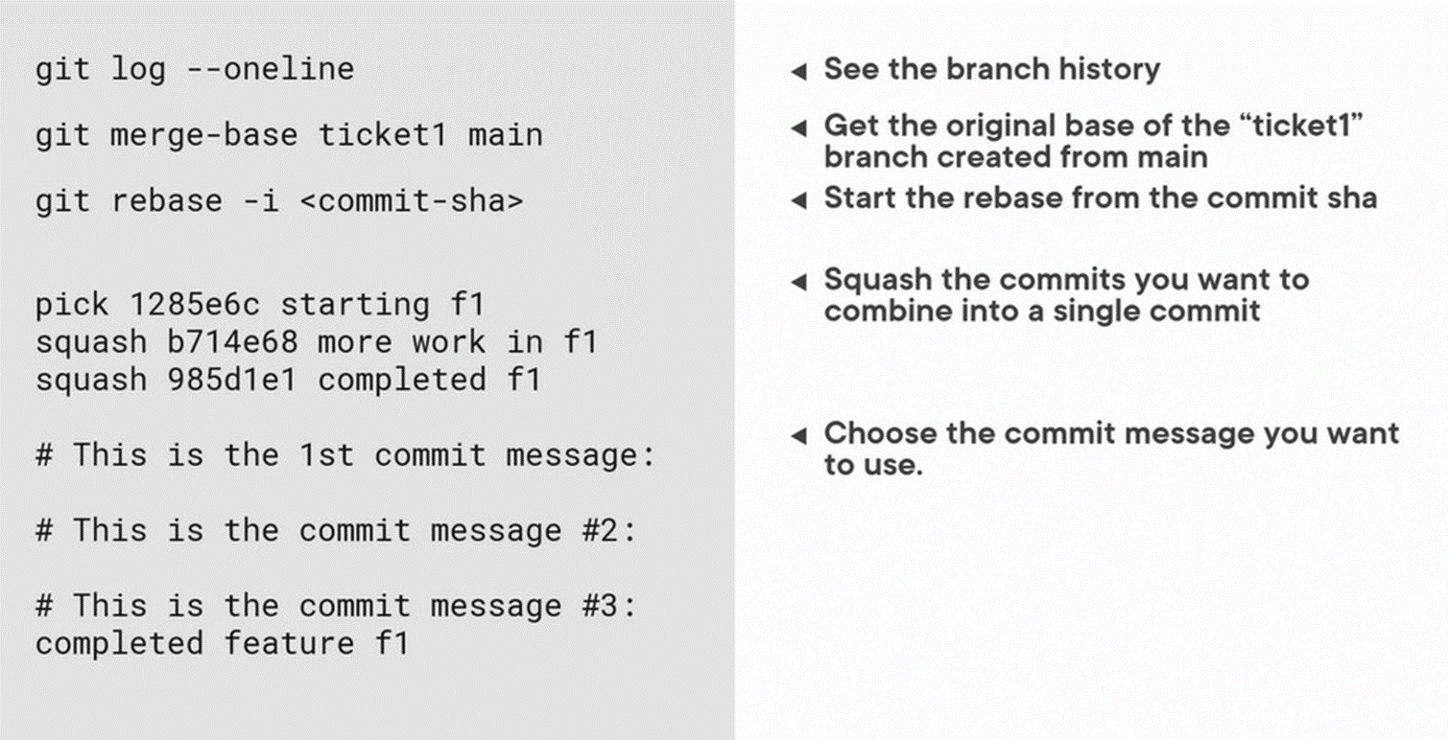
Git
Git Squash
You can merge several commits into a single commit with the compelling interactive rebase command.

Slide 25

Git
Git Cherry Pick
git cherry-pick is a powerful command that enables arbitrary Git commits to be picked by reference and appended to the current working HEAD.
Cherry picking is the act of picking a commit from a branch and applying it to another.
Syntax
git cherry-pick <commitSha>
When to use git Cherry Pick
Accidently make a commit in the wrong branch.
Bug hotfixes
Team collaboration.

Slide 26
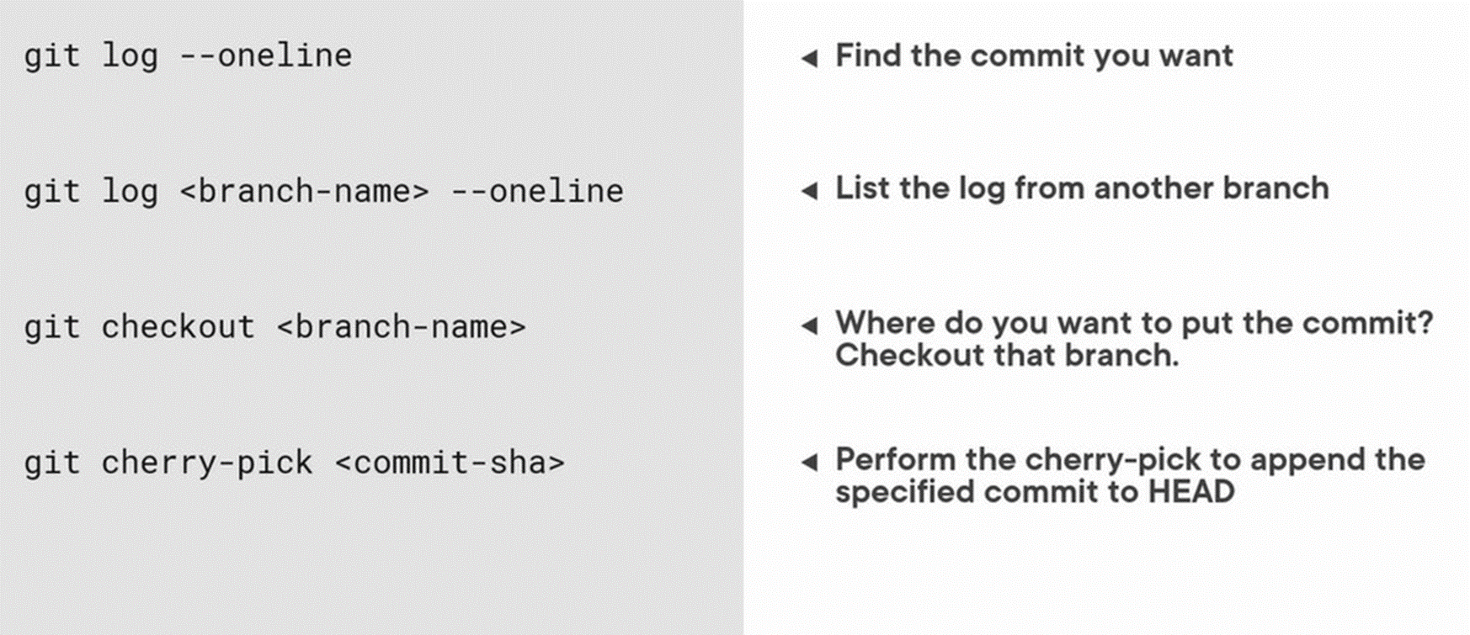
Git
Git Cherry Pick

Slide 27
GitHub
Assignment 1 : Git GitHub Flow
The GitHub flow works like this:
Create a GitHub repo
fork
Open a Pull Request
Make changes and add Commits
Review
Deploy
Merge
In a group, think of a simple project, one student to create a GitHub repo, the rest folk, create a pull-up request, using branches contribute to that project. Do not delete the branches. A project can be a simple website.

Slide 28
Git / GitHub
END

